Slide 1

“ Spell checking using
Deep Learning Approach”
Prepared by
0856706 Susan Ku & 0856156 Huong Vu
2020, October

Slide 2

Agenda
Introduction
Background Theory
Dataset
Expected results
Conclusion

Slide 3

Introduction
Background theory
Dataset
Expected results
Conclusion
Motivation
Problem Statement
Not everyone can be a spelling bee
Misspelling or typo happens all the time
Out- dated dictionaries
Different causes of spelling errors
Spelling corrections for a given word in English

Slide 4
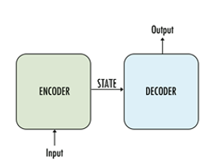
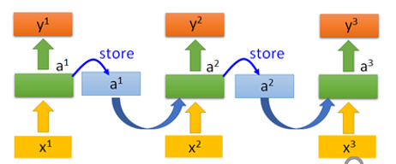
Introduction
Background Theory
Dataset
Expected results
Conclusion
Sequence-to-Sequence Model (seq2seq):
Map a fixed length input sequence to a fixed-length output sequence through and encoder-decoder neural network, where the length of the input and output may differ
Recurrent Neural Network (RNN):
Neural network with memory

Slide 5
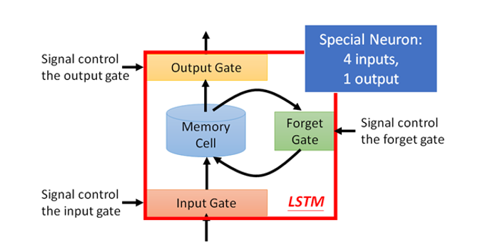
Introduction
Background Theory
Dataset
Expected results
Conclusion
Long Short – Term Memory (LSTM):
To overcome vanishing gradient problem in RNN

Slide 6
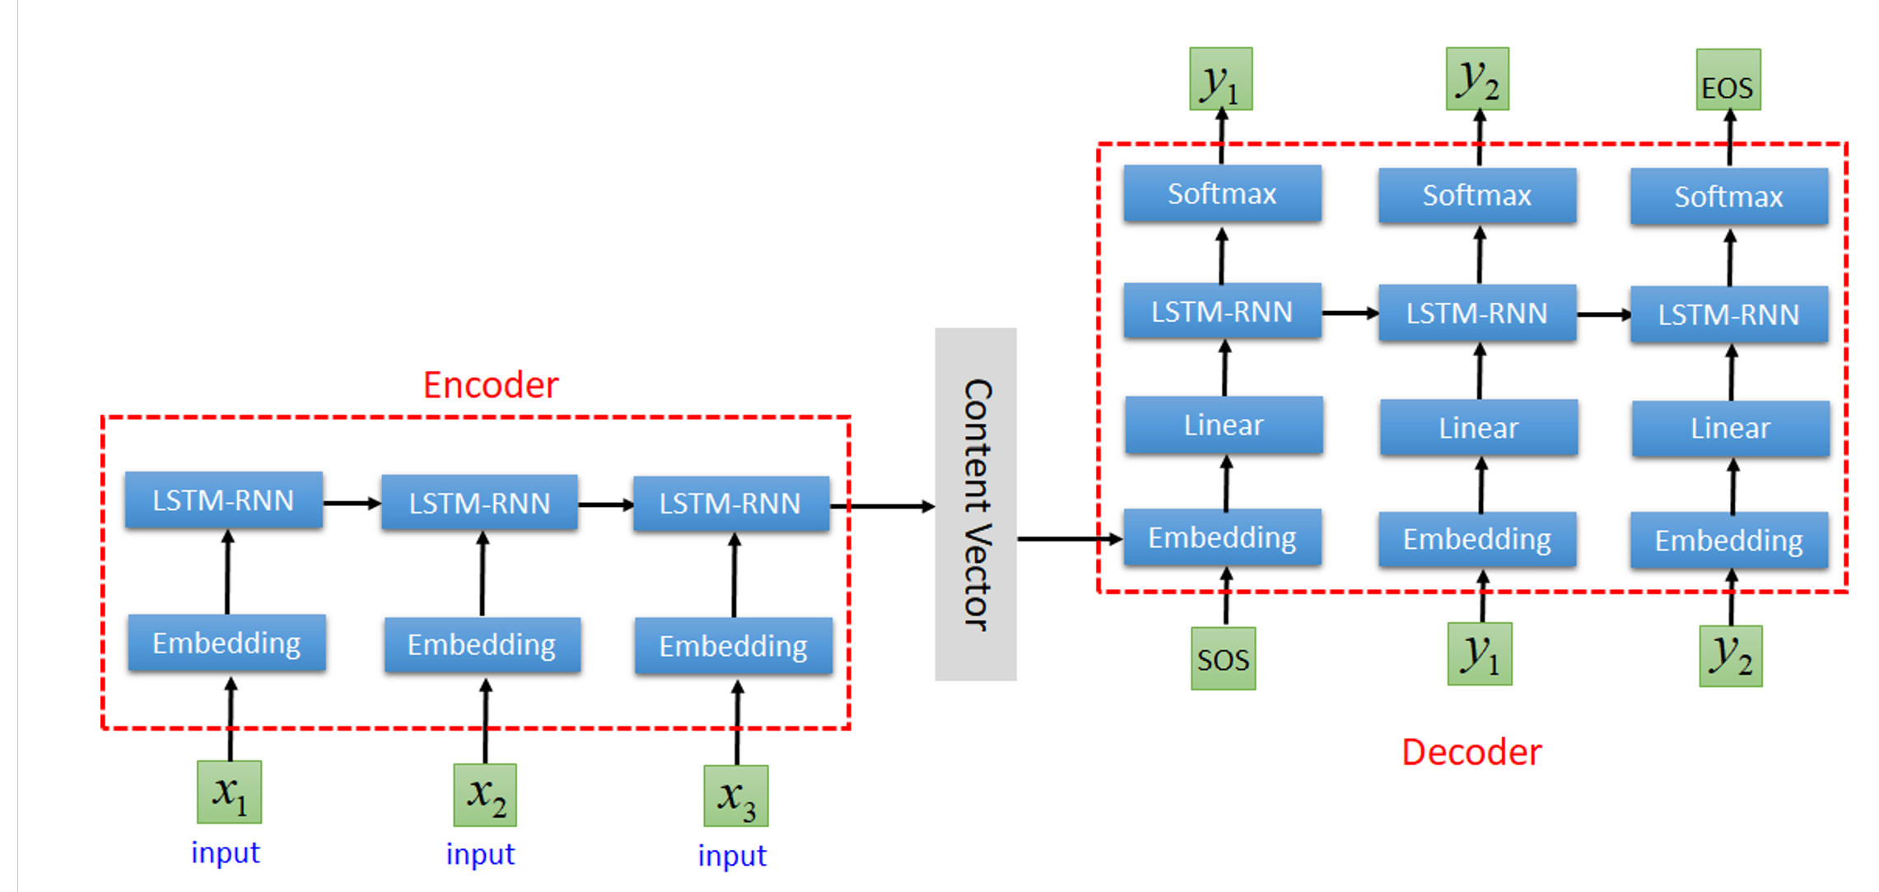
Introduction
Background Theory
Dataset
Expected results
Conclusion
Proposed Architecture

Slide 7
Introduction
Background Theory
Dataset
Expected results
Conclusion
80% training
Assign a number to all characters in the alphabet
Each character in a word can be regarded as a vector.
Implementing a dataloader
Using <start of string> & <end of string> toke to let the decoder know when the strings starts and ends
40,910 misspellings of 9,708 English words
20% testing
Collection of corpora of misspellings:
birkbeck, holbrook, aspell, Wikipedia

Slide 8
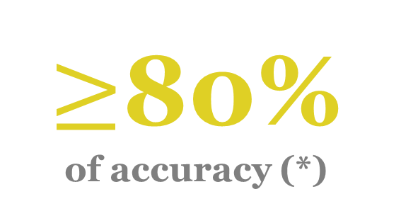
Introduction
Background Theory
Dataset
Expected results
Conclusion
Diminishing Cross Entropy Loss Function
(*) using BLEU-score for accuracy estimation

Slide 9
Introduction
Background Theory
Dataset
Expected results
Conclusion
Automatic spell-checking is so important and is applying everywhere
Our project is to use Seq-2-Sep translator to perform spellchecking of English words using corpus of most common spelling mistakes

Slide 10
Q&A

